Slide 1
COVID-19 UPDATES
31 March 2022

Slide 2
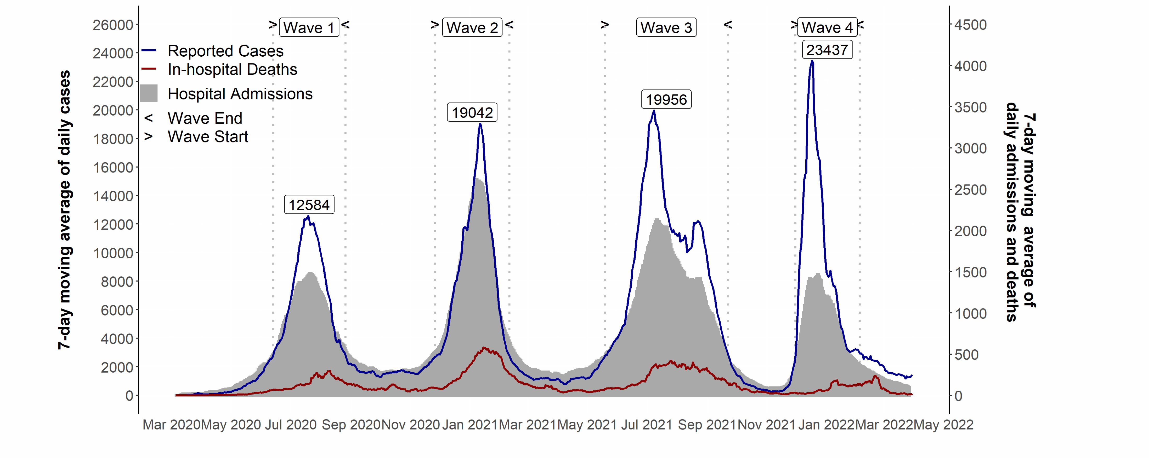
Covid-19 in South Africa
Covid-19 in South Africa
up to – 30 March 2022
  Source of hospital admissions data: Lucille Blumberg, Richard Welch and Waasila Jassat – DATCOV, NICD

Slide 3
SARS-Cov-2 cases in 1st, 2nd & 3rd and 4th waves: South Africa
up to - 30 March 2022
23437 cases
19956 cases
19042 cases
Waves aligned at a threshold of 5 cases per 100,000 population.
12584 cases
Data source: Department of Health; Analysis: Marothi LETSOALO; Ande MCHUNU

Slide 4
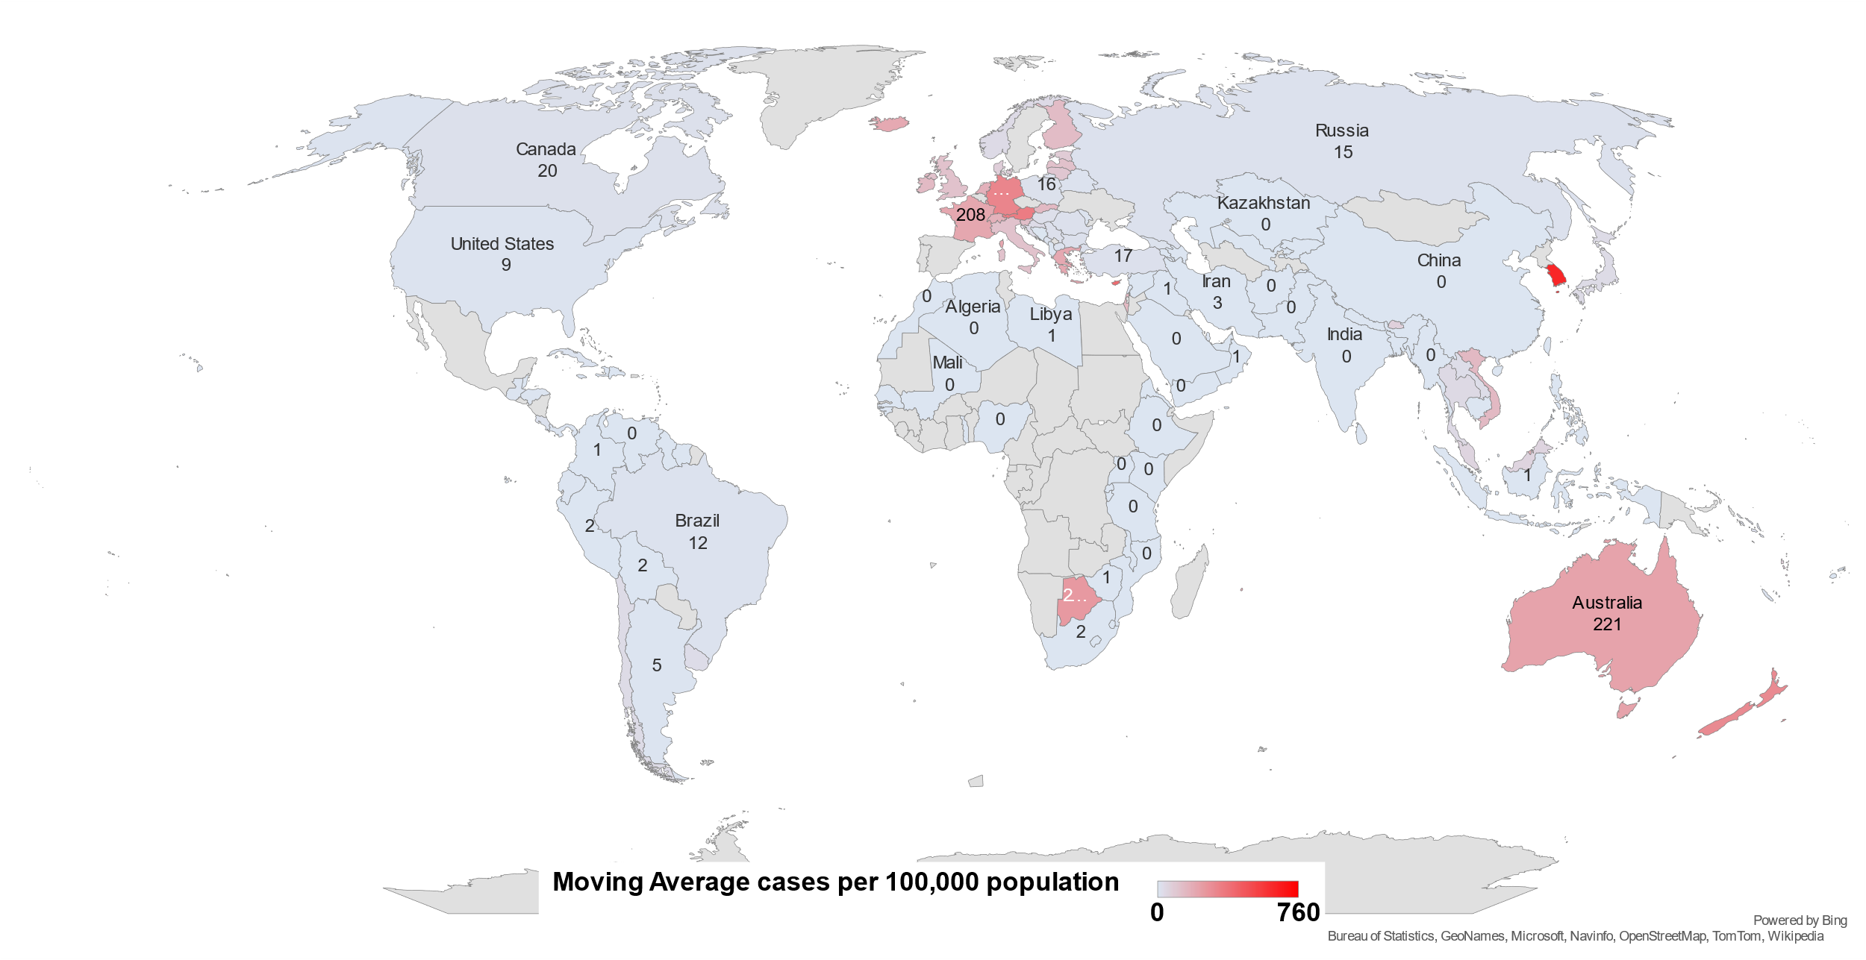
Global Covid-19 epidemic
7-day moving average cases per 100,000 population
up to - 30 March 2022
  Source: Our World in Data
Notes:
Needs the date of this analysis. Make sure it is no later than a day or two behind the date on which we send It out.

Slide 5
Covid-19 in Africa
Omicron variant drives 4th wave
up to - 30 March 2022
* 476 million cumulative global case and 6.1 million deaths
  Data Source: Our World in Data; NICD

Slide 6
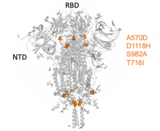
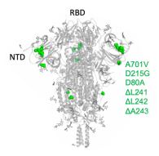
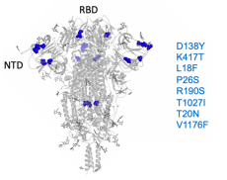
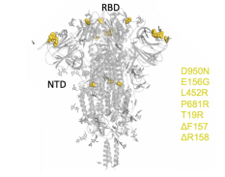
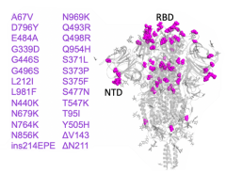
Key mutations in the spike protein for each variant of concern
α
β
γ
δ
ο
Alpha
(B.1.1.7, 20I/501Y.V1,
VOC 202012/01)
Beta
(B.1.351, 20H/501Y.V2)
Gamma
(P.1, B.1.1.28.1, 20J/501Y.V3)
Delta
(B.1.617.2, 21J)
Omicron
(B.1.1.529, BA.1, BA.2)
4 key mutations
6 key mutations
8 key mutations
7 key mutations
26 key mutations
Sep, 2020
Aug, 2020
Jul, 2020
Dec, 2020
Dec, 2021

Slide 7
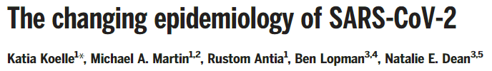

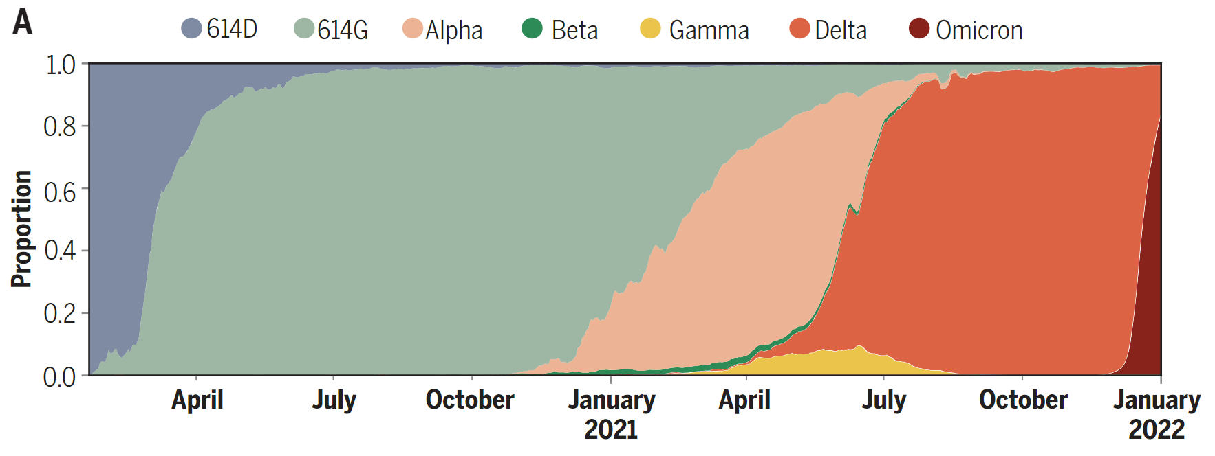
The frequencies of SARS-CoV-2 variants of concern over time
1st indication that SAR-CoV-2 was adapting to humans

Slide 8
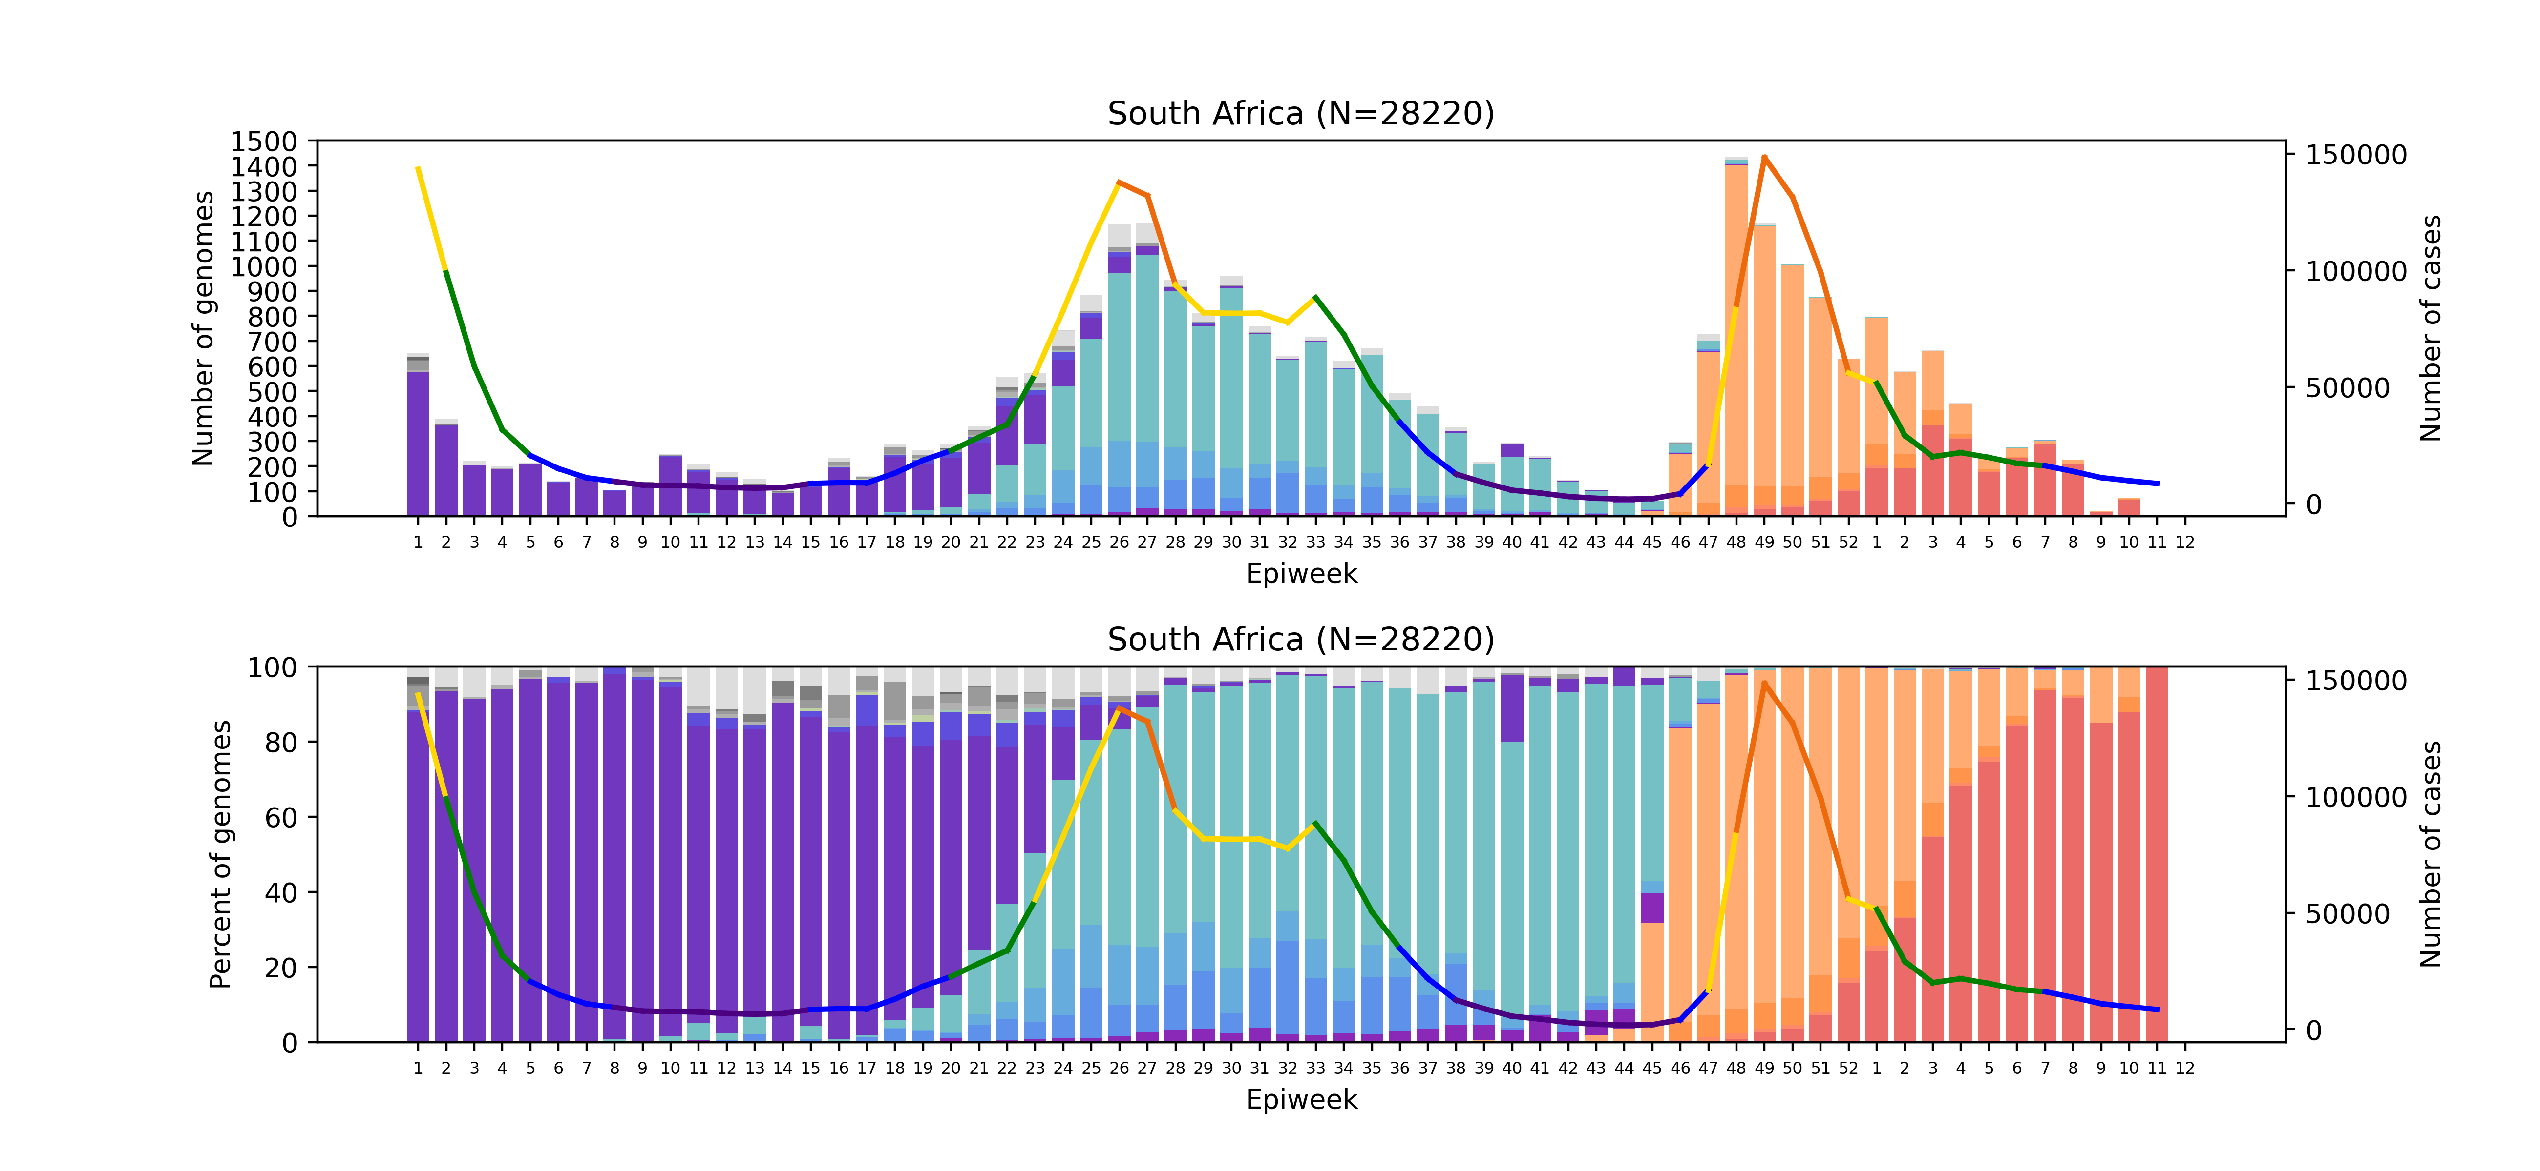
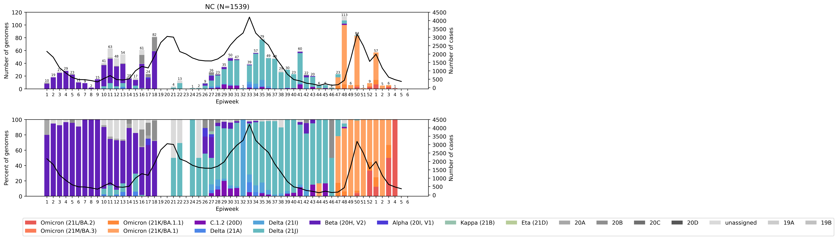

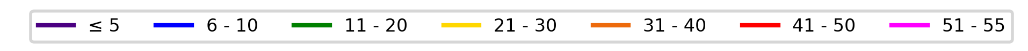
South Africa, 2021-2022, n = 28220*
Clade key (bar graph)
Cases
Weekly percentage testing positive key (line graph)
*Excludes sequences missing collection dates, as well as those collected January 1st and 2nd 2021 as they are part of epiweek 53 of 2020.

Slide 9

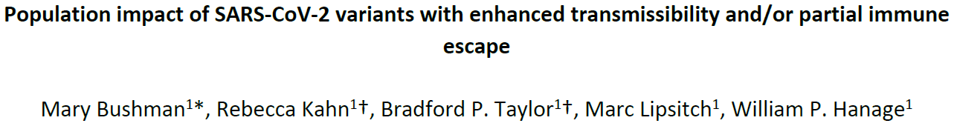
What will Pi look like? - Predicting the impact of future immune escape variants on the pandemic
Population impact of SARS-CoV-2 variants with enhanced transmissibility and/or partial immune
Characteristics of future variants:
More transmissible – faster doubling time
Immune escape – causes infection in those with natural & vaccine immunity
Moderate immune escape poses a low risk unless there is ↑ transmissibility
Severity due to viral virulence & existing immunity – past infection & vaccination

Slide 10
If there is a 5th wave in South Africa, when?
3 Feb
early May
Note: New variant and other factors may change epidemic trajectory. These estimations are based on several assumptions and not on mathematical modelling

Slide 11
Estimated effective reproduction rate (R) of Covid-19 in South Africa
up to - 25 March 2022
  Source: Our World in Data; data explorer; Johns Hopkins University COVID-19 Dashboard

Slide 12
Average daily tests and proportion of positive tests
up to - 30 March 2022
Cumulative number tests 4 Mar 2020 – 30 March 2022 = 23809344
  Data source: Department of Health

Slide 13
Proportion of individuals vaccinated as % of adult population
  Source: Department of Health. https://sacoronavirus.co.za/latest-vaccine-statistics/

Slide 14

Expected & actual all-cause deaths during Covid-19
Before lockdown
Excess deaths: 1007
Covid-19 deaths : 2
L5
Excess deaths: -4,276
Covid-19 deaths: 121
L4
Excess deaths:
-2,794
Covid-19 deaths: 525
L3
Excess deaths:
33,295
Covid-19 deaths:
11,008
L2
Excess deaths: 5,578
Covid-19 deaths: 4,363
L1
Excess deaths:
27,677
Covid-19 deaths:
10,581
L3
Excess deaths: 59,966
Covid-19 deaths: 17,430
L2
Excess deaths:6,728
Covid-19 deaths: 1343
L2
Excess deaths: 6,050
Covid-19 deaths: 3,002
L3 (readjusted)
Excess deaths: 12,544
Covid-19 deaths: 5,990
L3
Excess deaths: 7,852
Covid-19 deaths: 2,072
L1
Excess deaths: 4,287
Covid-19 deaths: 1,410
L1
Excess deaths:22,484
Covid-19 deaths: 6,455
L4: Excess deaths: 34,671
Covid-19 deaths: 9,710
L3
Excess deaths: 39,527
Covid-19 deaths: 15,263
Source: Bradshaw D, et al
Notes:
Level 5 – 26 March 2020
Level 4 – 1 May 2020
Level 3 – 1 June 2020
Level 2 – 16 Aug 2020
Level 1 – 20 Sept 2020
Level 3 adjusted – 29 Dec 2020
Level 3 readjusted – 6 Feb 2021
Level 1 – 4 March 2021
Level 2 – 30 May 2021
Level 3 – 16 June 2021
Level 4 – 30 June 2021
Level 3 – 26 July 2021
Level 2 – 13 September 2021
Level 1 – 1 Oct 2021

Slide 15
Weekly excess all cause deaths & reported Covid-19 deaths
Before lockdown
Excess deaths: 1007
Covid-19 deaths : 2
L5
Excess deaths: -4,276
Covid-19 deaths: 121
L4
Excess deaths:
-2,794
Covid-19 deaths: 525
L3
Excess deaths:
33,295
Covid-19 deaths:
11,008
L2
Excess deaths: 5,578
Covid-19 deaths: 4,363
L1
Excess deaths:
27,677
Covid-19 deaths:
10,581
L3
Excess deaths: 59,966
Covid-19 deaths: 17,430
L2
Excess deaths:6,728
Covid-19 deaths: 1343
L3 (readjusted)
Excess deaths: 12,544
Covid-19 deaths: 5,990
L3
Excess deaths: 7,852
Covid-19 deaths: 2,072
L4: Excess deaths: 34,671
Covid-19 deaths: 9,710
L1
Excess deaths:22,484
Covid-19 deaths: 6,455
L3
Excess deaths: 39,527
Covid-19 deaths: 15,263
L2
Excess deaths: 6,050
Covid-19 deaths: 3,002
L1
Excess deaths: 4,287
Covid-19 deaths: 1,410
Source: Bradshaw D, et al
Notes:
No update this week
Level 5 – 26 March 2020
Level 4 – 1 May 2020
Level 3 – 1 June 2020
Level 2 – 16 Aug 2020
Level 1 – 20 Sept 2020
Level 3 adjusted – 29 Dec 2020
Level 3 readjusted – 6 Feb 2021
Level 1 – 4 March 2021
Level 2 – 30 May 2021
Level 3 – 16 June 2021
Level 4 – 30 June 2021
Level 3 – 26 July 2021

Slide 16
South Africa Provincial SARS-CoV-2 cases in the 4 waves

Slide 17
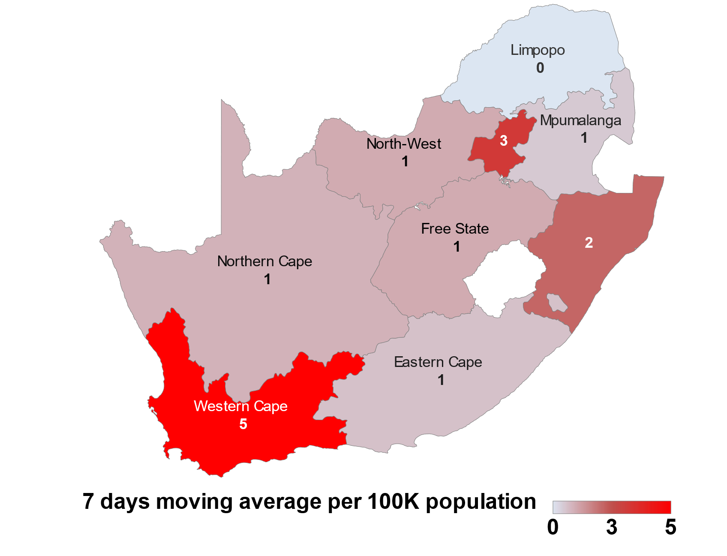
Daily new cases over last 7 days/100,000
up to - 30 March 2022
  Data source: Department of Health

Slide 18
Confirmed SARS-Cov-2 cases by province
  Data source: Department of Health; Analysis

Slide 19
SARS-Cov-2 cases in 1st, 2nd & 3rd and 4th waves: Gauteng
  Data source: Department of Health; Analysis: Marothi Letsoalo; Ande Mchunu
Notes:
No update this week
Level 5 – 26 March 2020
Level 4 – 1 May 2020
Level 3 – 1 June 2020
Level 2 – 16 Aug 2020
Level 1 – 20 Sept 2020
Level 3 adjusted – 29 Dec 2020
Level 3 readjusted – 6 Feb 2021
Level 1 – 4 March 2021
Level 2 – 30 May 2021
Level 3 – 16 June 2021
Level 4 – 30 June 2021
Level 3 – 26 July 2021

Slide 20
SARS-Cov-2 cases in 1st, 2nd & 3rd and 4th waves: Limpopo
  Data source: Department of Health; Analysis: Marothi Letsoalo; Ande Mchunu
Notes:
No update this week
Level 5 – 26 March 2020
Level 4 – 1 May 2020
Level 3 – 1 June 2020
Level 2 – 16 Aug 2020
Level 1 – 20 Sept 2020
Level 3 adjusted – 29 Dec 2020
Level 3 readjusted – 6 Feb 2021
Level 1 – 4 March 2021
Level 2 – 30 May 2021
Level 3 – 16 June 2021
Level 4 – 30 June 2021
Level 3 – 26 July 2021

Slide 21
SARS-Cov-2 cases in 1st, 2nd & 3rd and 4th waves: North West
1369 cases
1300 cases
768 cases
  Data source: Department of Health; Analysis: Marothi Letsoalo; Ande Mchunu
Notes:
No update this week
Level 5 – 26 March 2020
Level 4 – 1 May 2020
Level 3 – 1 June 2020
Level 2 – 16 Aug 2020
Level 1 – 20 Sept 2020
Level 3 adjusted – 29 Dec 2020
Level 3 readjusted – 6 Feb 2021
Level 1 – 4 March 2021
Level 2 – 30 May 2021
Level 3 – 16 June 2021
Level 4 – 30 June 2021
Level 3 – 26 July 2021

Slide 22
SARS-Cov-2 cases in 1st, 2nd & 3rd and 4th waves: Mpumalanga
  Data source: Department of Health; Analysis: Marothi Letsoalo; Ande Mchunu
Notes:
No update this week
Level 5 – 26 March 2020
Level 4 – 1 May 2020
Level 3 – 1 June 2020
Level 2 – 16 Aug 2020
Level 1 – 20 Sept 2020
Level 3 adjusted – 29 Dec 2020
Level 3 readjusted – 6 Feb 2021
Level 1 – 4 March 2021
Level 2 – 30 May 2021
Level 3 – 16 June 2021
Level 4 – 30 June 2021
Level 3 – 26 July 2021

Slide 23
SARS-Cov-2 cases in 1st, 2nd & 3rd and 4th waves: Northern Cape
  Data source: Department of Health; Analysis: Marothi Letsoalo; Ande Mchunu
Notes:
No update this week
Level 5 – 26 March 2020
Level 4 – 1 May 2020
Level 3 – 1 June 2020
Level 2 – 16 Aug 2020
Level 1 – 20 Sept 2020
Level 3 adjusted – 29 Dec 2020
Level 3 readjusted – 6 Feb 2021
Level 1 – 4 March 2021
Level 2 – 30 May 2021
Level 3 – 16 June 2021
Level 4 – 30 June 2021
Level 3 – 26 July 2021

Slide 24
SARS-Cov-2 cases in 1st, 2nd & 3rd and 4th waves: Free State
  Data source: Department of Health; Analysis: Marothi Letsoalo; Ande Mchunu
Notes:
No update this week
Level 5 – 26 March 2020
Level 4 – 1 May 2020
Level 3 – 1 June 2020
Level 2 – 16 Aug 2020
Level 1 – 20 Sept 2020
Level 3 adjusted – 29 Dec 2020
Level 3 readjusted – 6 Feb 2021
Level 1 – 4 March 2021
Level 2 – 30 May 2021
Level 3 – 16 June 2021
Level 4 – 30 June 2021
Level 3 – 26 July 2021

Slide 25
SARS-Cov-2 cases in 1st, 2nd & 3rd and 4th waves: KwaZulu Natal
  Data source: Department of Health; Analysis: Marothi Letsoalo; Ande Mchunu
Notes:
No update this week
Level 5 – 26 March 2020
Level 4 – 1 May 2020
Level 3 – 1 June 2020
Level 2 – 16 Aug 2020
Level 1 – 20 Sept 2020
Level 3 adjusted – 29 Dec 2020
Level 3 readjusted – 6 Feb 2021
Level 1 – 4 March 2021
Level 2 – 30 May 2021
Level 3 – 16 June 2021
Level 4 – 30 June 2021
Level 3 – 26 July 2021

Slide 26
SARS-Cov-2 cases in 1st, 2nd & 3rd and 4th waves: Western Cape
3629 cases
3256 cases
  Data source: Department of Health; Analysis: Marothi Letsoalo; Ande Mchunu
Notes:
No update this week
Level 5 – 26 March 2020
Level 4 – 1 May 2020
Level 3 – 1 June 2020
Level 2 – 16 Aug 2020
Level 1 – 20 Sept 2020
Level 3 adjusted – 29 Dec 2020
Level 3 readjusted – 6 Feb 2021
Level 1 – 4 March 2021
Level 2 – 30 May 2021
Level 3 – 16 June 2021
Level 4 – 30 June 2021
Level 3 – 26 July 2021

Slide 27
SARS-Cov-2 cases in 1st, 2nd & 3rd and 4th waves: Eastern Cape
  Data source: Department of Health; Analysis: Marothi Letsoalo; Ande Mchunu
Notes:
No update this week
Level 5 – 26 March 2020
Level 4 – 1 May 2020
Level 3 – 1 June 2020
Level 2 – 16 Aug 2020
Level 1 – 20 Sept 2020
Level 3 adjusted – 29 Dec 2020
Level 3 readjusted – 6 Feb 2021
Level 1 – 4 March 2021
Level 2 – 30 May 2021
Level 3 – 16 June 2021
Level 4 – 30 June 2021
Level 3 – 26 July 2021

